Slide 1
Assignment No.: - 3 on Visualization through tableau Submitted by: Pralay Kalaskar 20OKCMD061 Technology for management MBA – B (2020-2022) Submitted to: Abishek Santhosh Raj Assistant Professor NSB Academy, Bangalore Karnataka, 560100. Date of submission: - 11 / 10 / 2021

Slide 2
Visualization through Tableau

Slide 3
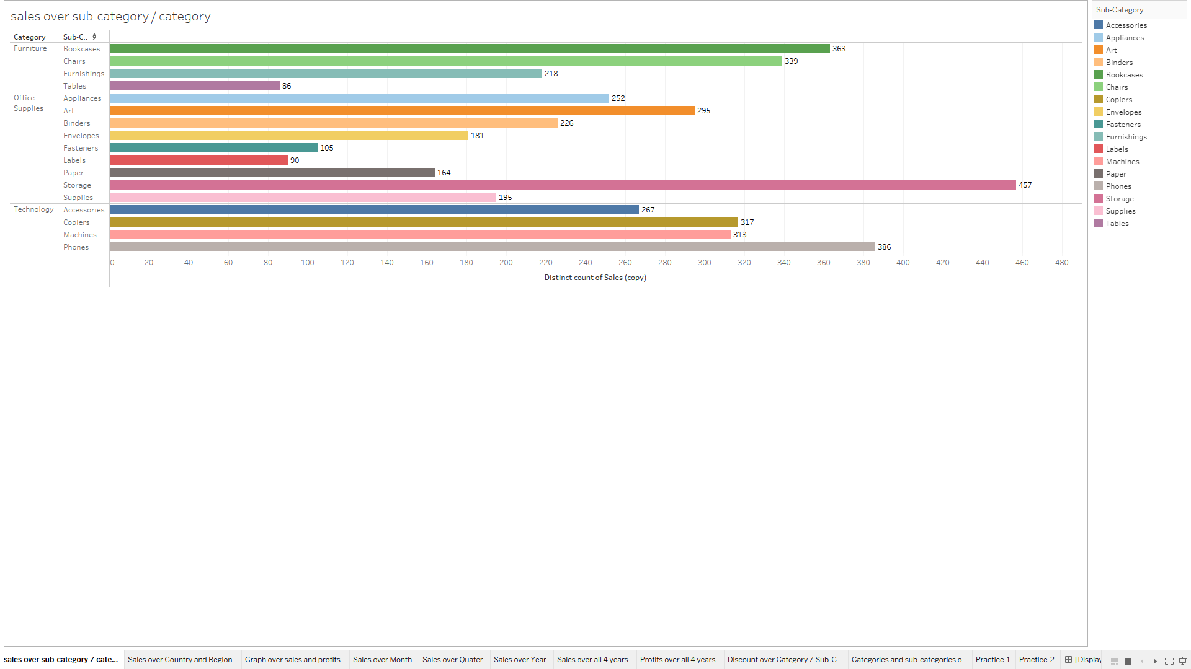

Slide 4
By seeing this graph we can understand that the graph is explaining about the relationship between category, sub-category by distinct count of sales.
Sales number is representing that how many sales is done in that category or sub-category.
Every sub-category is having their different colour code.
In furniture category: -
The lowest discount is in ‘tables’ sub-category and that is 86
In office supplies category: -
The lowest discount is in ‘labels’ sub-category and that is 90
In technology category: -
The lowest discount is in ‘accessories’ sub-category and that is 256
The highest discount is in ‘bookcases’ sub-category and that is 363
The highest discount is in ‘storage’ sub-category and that is 457
The highest discount is in ‘phones’ sub-category and that is 386

Slide 5
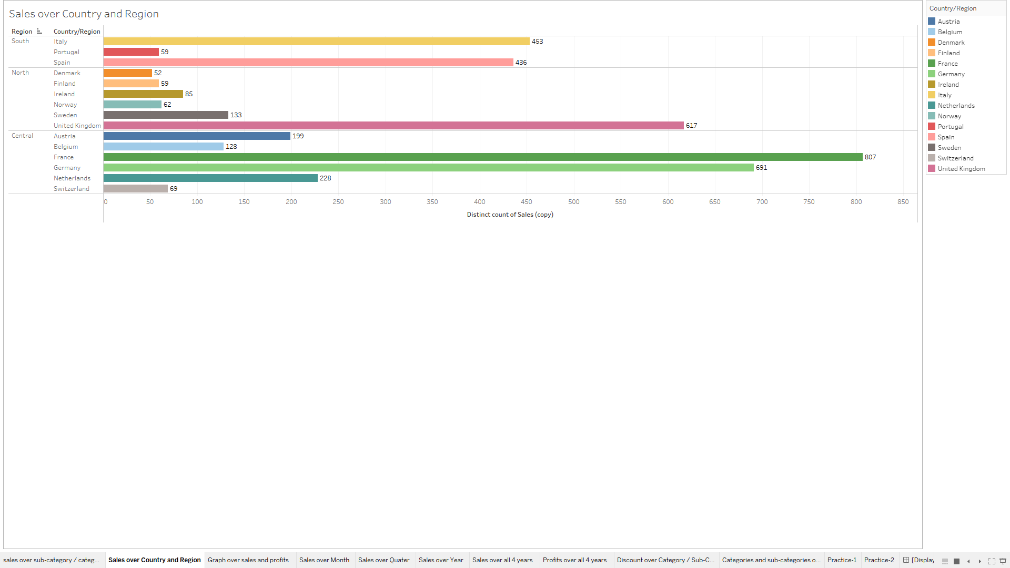

Slide 6
The previous graph is explaining about the sale over category and sub-category, and this graph is giving information about the sales over country and region.
Sales number is representing that how many sales is done in that country or region.
Every region is having their different colour code for showing sales.
In south region: -
The lowest sales is in ‘Portugal’ country/region and that is 59
In north region: -
The lowest sales is in ‘Denmark’ country/region and that is 52
In central region: -
The lowest sales is in ‘Switzerland’ country/region and that is 69
The highest sales is in ‘Italy’ country/region and that is 453
The highest sales is in ‘United Kingdom’ country/region and that is 617
The highest sales is in ‘France’ country/region and that is 807

Slide 7
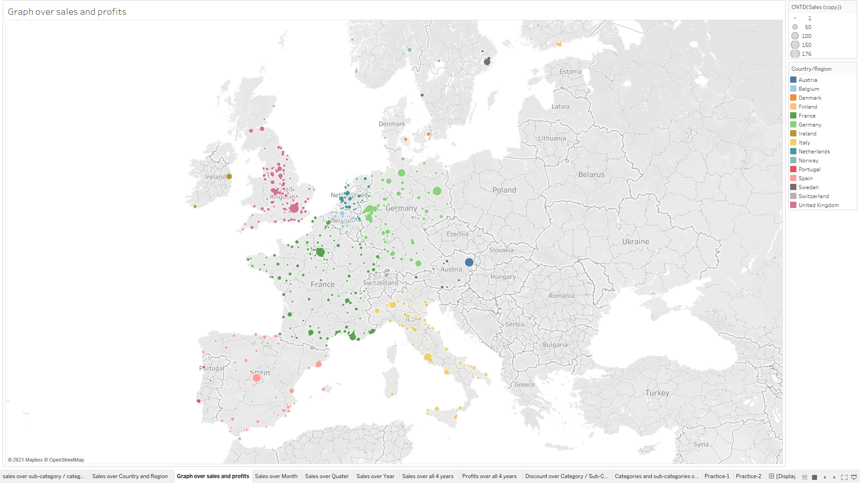

Slide 8
This graph is showing the details about the sales and profit in geographical format which includes the city, country/region, state/province, distinct count of sales, distinct count of profit.
Sales and Profit are represented as the size of the circles, the smaller the circle the less is sales and profits and the bigger circles shows more sales and profits.
Every region is having their different colour code for showing sales.
By just clicking on the dots we will get all the details for which graph is meant for.
It will help in taking decision that where the sale and profit is loss.

Slide 9
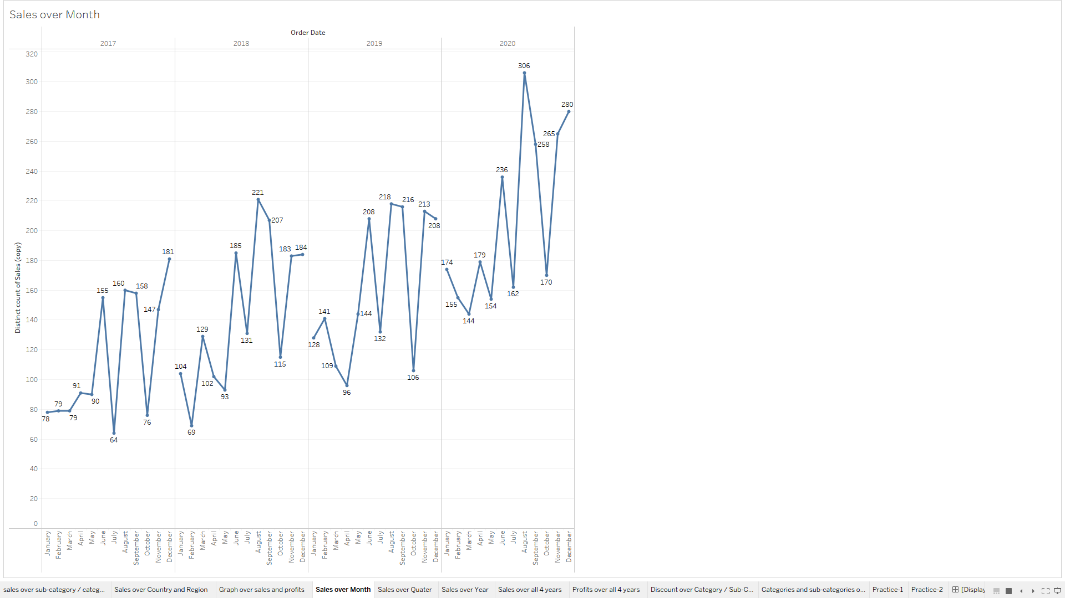

Slide 10
This graph is explaining about the relationship between sales over month and years.
As we can see this graph is showing us the sales by month-wise and year-wise.
2017
The minimum sales is in January month with 78
2018
The minimum sales is in February month with 69
2020
The minimum sales is in March month with 144
2019
The maximum sales is in December month with 181
The maximum sales is in August month with 221
The maximum sales is in August month with 306
The minimum sales is in April month with 96
The maximum sales is in August month with 218

Slide 11
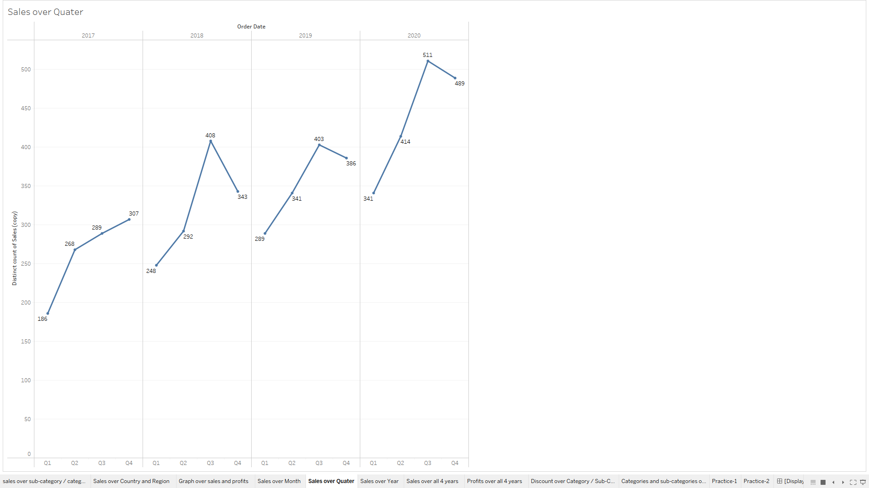

Slide 12
This graph is explaining about the relationship between sales over quarter and year.
As we can see this graph is showing us the sales in quarter-wise and year-wise.
2017
The minimum sales is in Q1 with 186
2018
The minimum sales is in Q1 with 248
2020
The minimum sales is in Q1 with 341
2019
The minimum sales is in Q1 with 289
The maximum sales is in Q4 with 307
The and maximum sales is in Q3 with 408
The maximum sales is in Q3 with 403
The maximum sales is in Q3 with 511

Slide 13
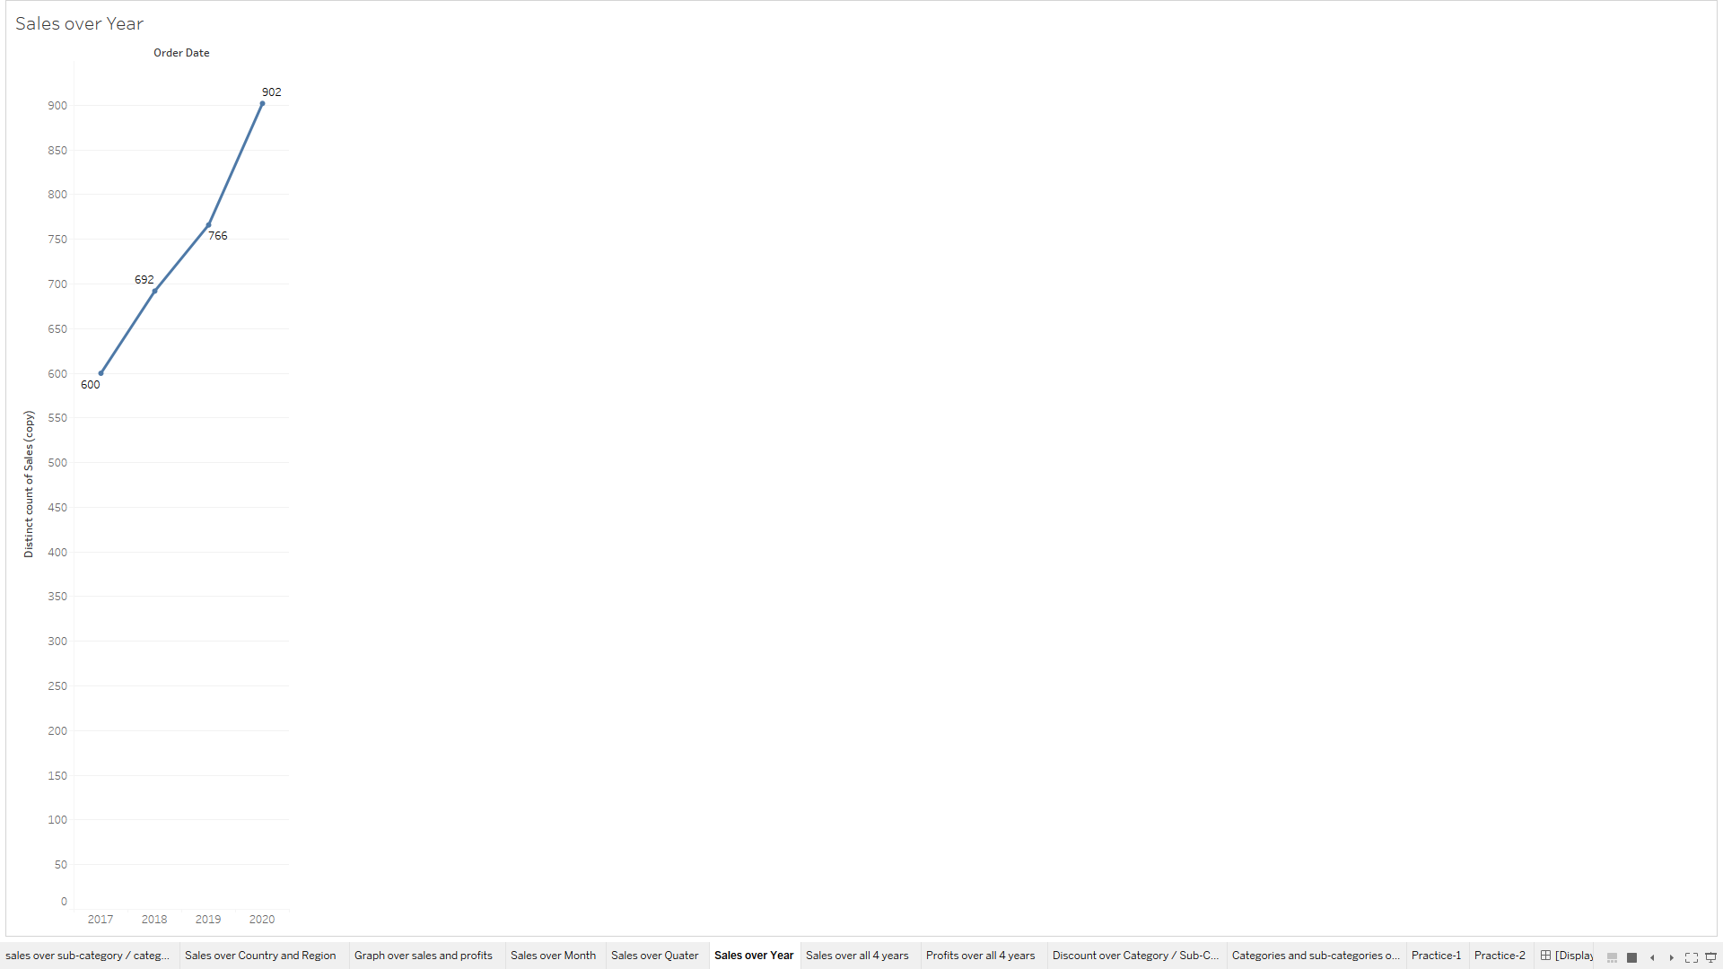

Slide 14
This graph is explaining about the relationship between sales over year.
As we can see this graph is showing us the sales in year-wise.
In the year 2017, the sales was 600.
In the year 2018, the sales 692.
In the year 2019, the sales is 766.
In the year 2020, the sales is 902.
The minimum sales was in the year 2017.
The maximum sales is achieved in the year 2020.

Slide 15
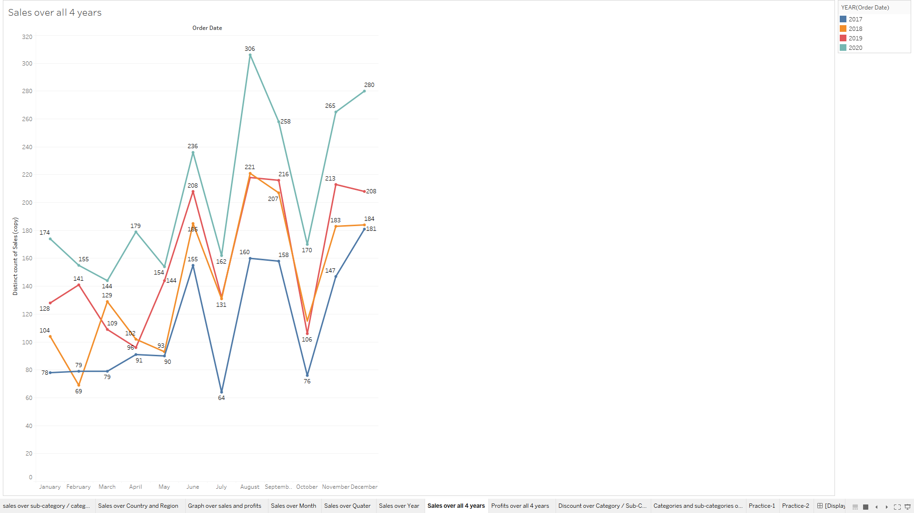

Slide 16
This graph is explaining about the relationship between sales by month-wise for all 4 years.
As compared to last graph this graph is more precise because its showing sales by month-wise for all the years as that would be much easy for seeing, understanding, viewing and taking important decisions.
Month-wise and year-wise data is shown with respect to sales.
Each year is indicated with different colour.
In the year 2017, the minimum sales is in January month with 78 and maximum sales is in December month with 181.
In the year 2018, the minimum sales is in February month with 69 and maximum sales is in August month with 221.
In the year 2019, the minimum sales is in April month with 96 and maximum sales is in August month with 218.
In the year 2020, the minimum sales is in March month with 144 and maximum sales is in August month with 306.

Slide 17
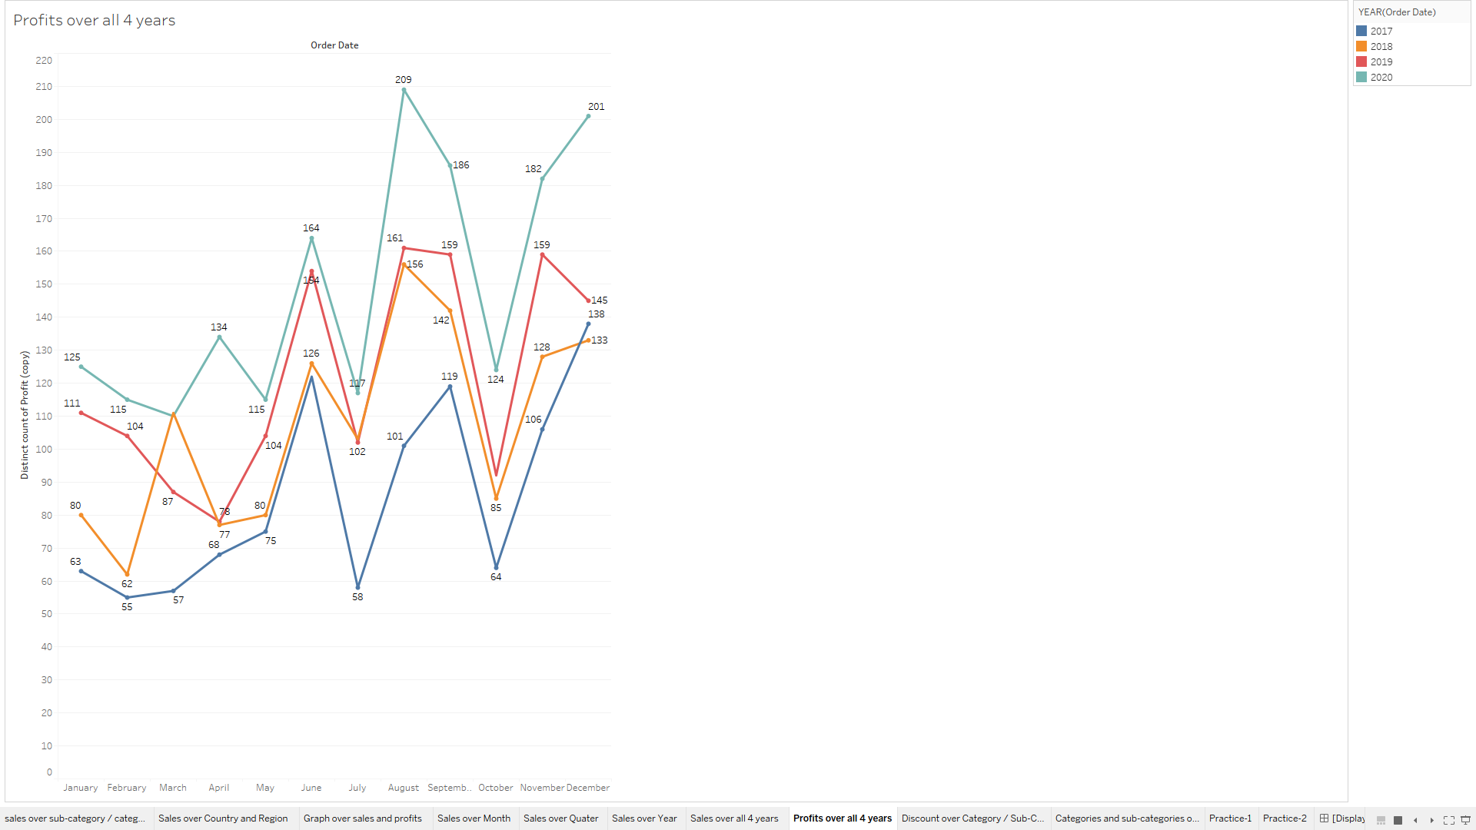

Slide 18
This graph is explaining about the relationship between profit by month-wise for all 4 years.
As compared to last graph this graph is more precise because its showing profit by month-wise for all the years as that would be much easy for seeing, understanding, viewing and taking important decisions.
Month-wise and year-wise data is shown with respect to profit.
Each year is indicated with different colour.
In the year 2017, the minimum profit is in February month with 55 and maximum profit is in December month with 138.
In the year 2018, the minimum profit is in February month with 62 and maximum profit is in August month with 156.
In the year 2019, the minimum profit is in April month with 78 and maximum profit is in August month with 161.
In the year 2020, the minimum profit is in March month with 110 and maximum profit is in August month with 209.

Slide 19
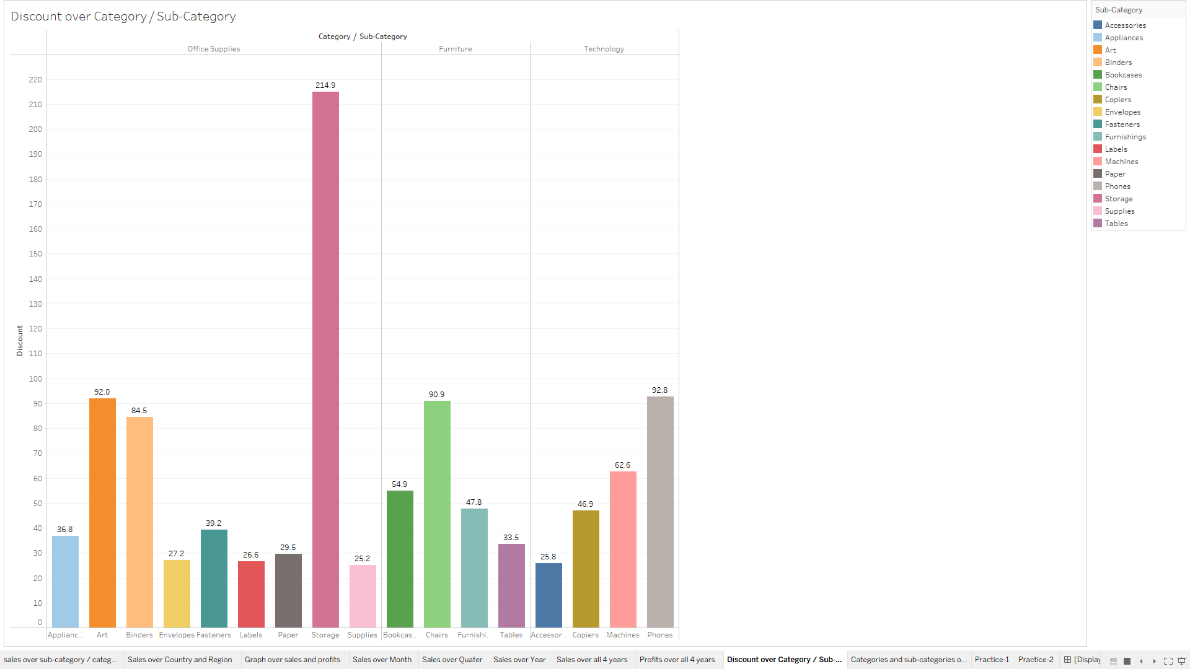

Slide 20
By seeing this graph we can understand that the graph is explaining about the relationship between category, sub-category by discount.
Discount number is representing that how many discount is given in that category or sub-category.
Every sub-category is having their different colour code.
In office supplies category: -
The lowest discount is in ‘supplies’ sub-category and that is 25.2
In furniture category: -
The lowest discount is in ‘tables’ sub-category and that is 33.5
In technology category: -
The lowest discount is in ‘accessories’ sub-category and that is 25.8
The highest discount is in ‘storage’ sub-category and that is 214.9
The highest discount is in ‘chairs’ sub-category and that is 90.9
The highest discount is in ‘phones’ sub-category and that is 92.8

Slide 21
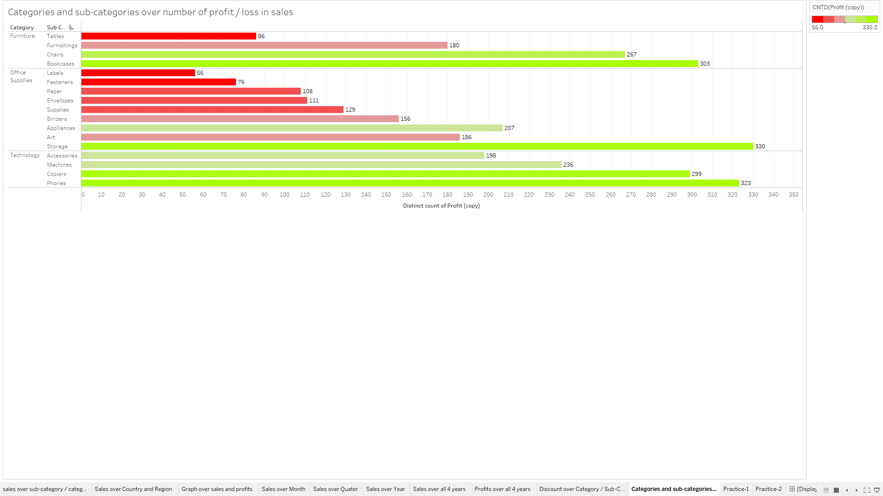

Slide 22
By seeing this graph we can understand that the graph is explaining about the relationship between category, sub-category by profit.
Profit number is representing that how many sales is done in that category or sub-category.
Every sub-category is having their different colour code.
In furniture category: -
The lowest profit is in ‘tables’ sub-category and that is 86
In office supplies category: -
The lowest profit is in ‘labels’ sub-category and that is 56
In technology category: -
The lowest discount is in ‘accessories’ sub-category and that is 198
The highest profit is in ‘bookcases’ sub-category and that is 303
The highest profit is in ‘storage’ sub-category and that is 330
The highest discount is in ‘phones’ sub-category and that is 323

Slide 23
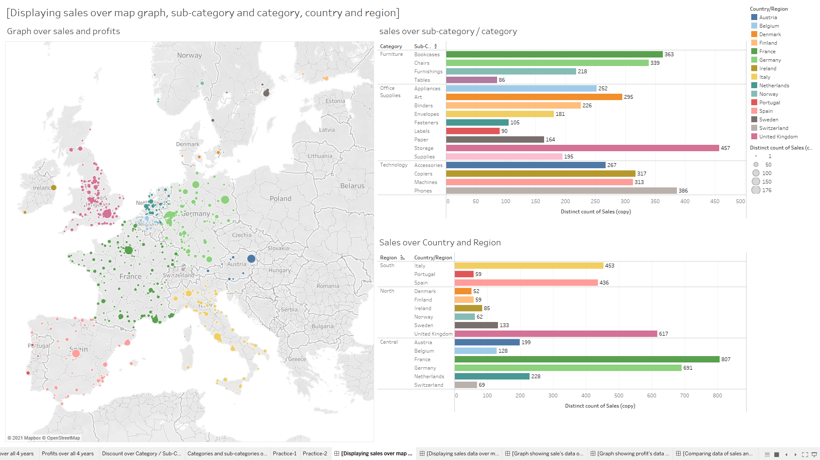

Slide 24
By seeing this dashboard1 we can understand that the graphs are inter-related with each other and explaining, displaying about sales with different graphs having different relation with variables.
The 3 graphs are as follows: -
Sales over graph map i.e. graphical representation.
Sales by category and sub-category.
Sales by region and country.
All graphs are inter-related with each other, so that if you click in any of the variable of any graph then there will be changes in all 3 of the graphs.

Slide 25
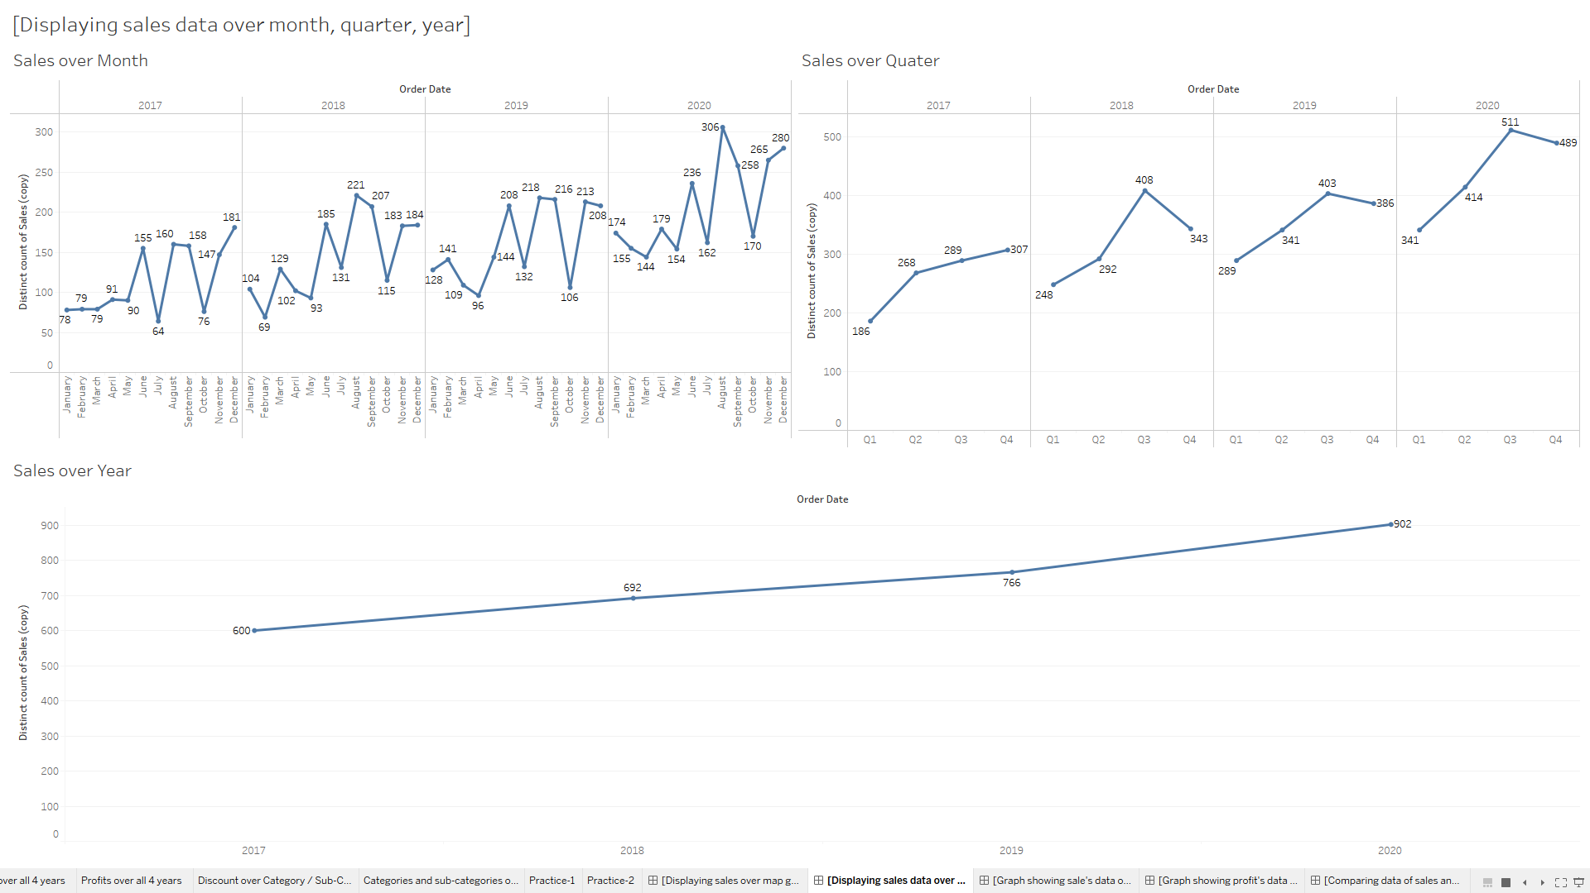

Slide 26
By seeing this dashboard2 we can understand that the graphs are inter-related with each other and explaining, displaying about sales with different graphs having different relation with variables.
The 3 graphs are as follows: -
Sales over month.
Sales over quarter.
Sales over year.
All graphs are inter-related with each other, so that if you click in any of the variable of any graph then there will be changes in all 3 of the graphs.

Slide 27
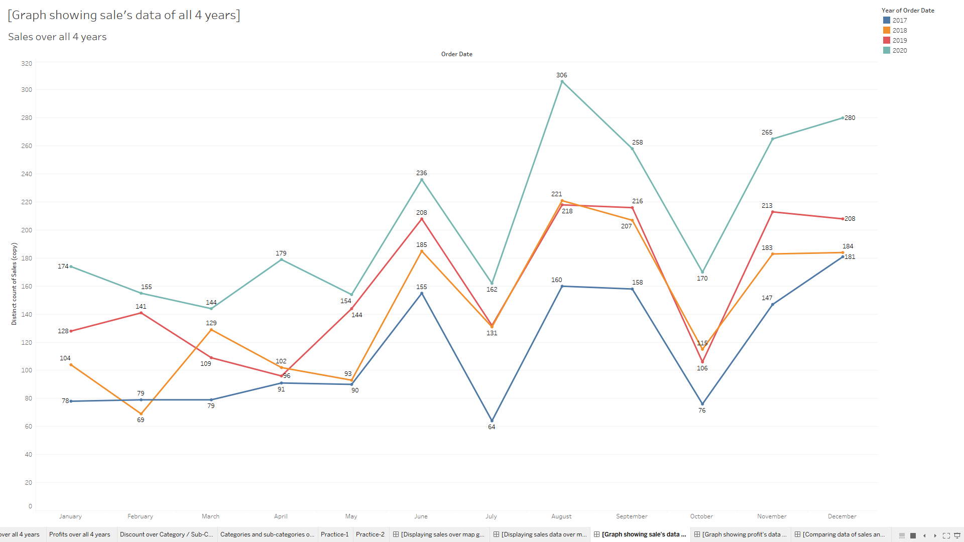

Slide 28
This dashboard3 is explaining about the relationship between sales by month-wise for all 4 years.
As compared to last graph this graph is more precise because its showing sales by month-wise for all the years as that would be much easy for seeing, understanding, viewing and taking important decisions.
Month-wise and year-wise data is shown with respect to sales.
Each year is indicated with different colour.
In the year 2017, the minimum sales is in January month with 78 and maximum sales is in December month with 181.
In the year 2018, the minimum sales is in February month with 69 and maximum sales is in August month with 221.
In the year 2019, the minimum sales is in April month with 96 and maximum sales is in August month with 218.
In the year 2020, the minimum sales is in March month with 144 and maximum sales is in August month with 306.

Slide 29
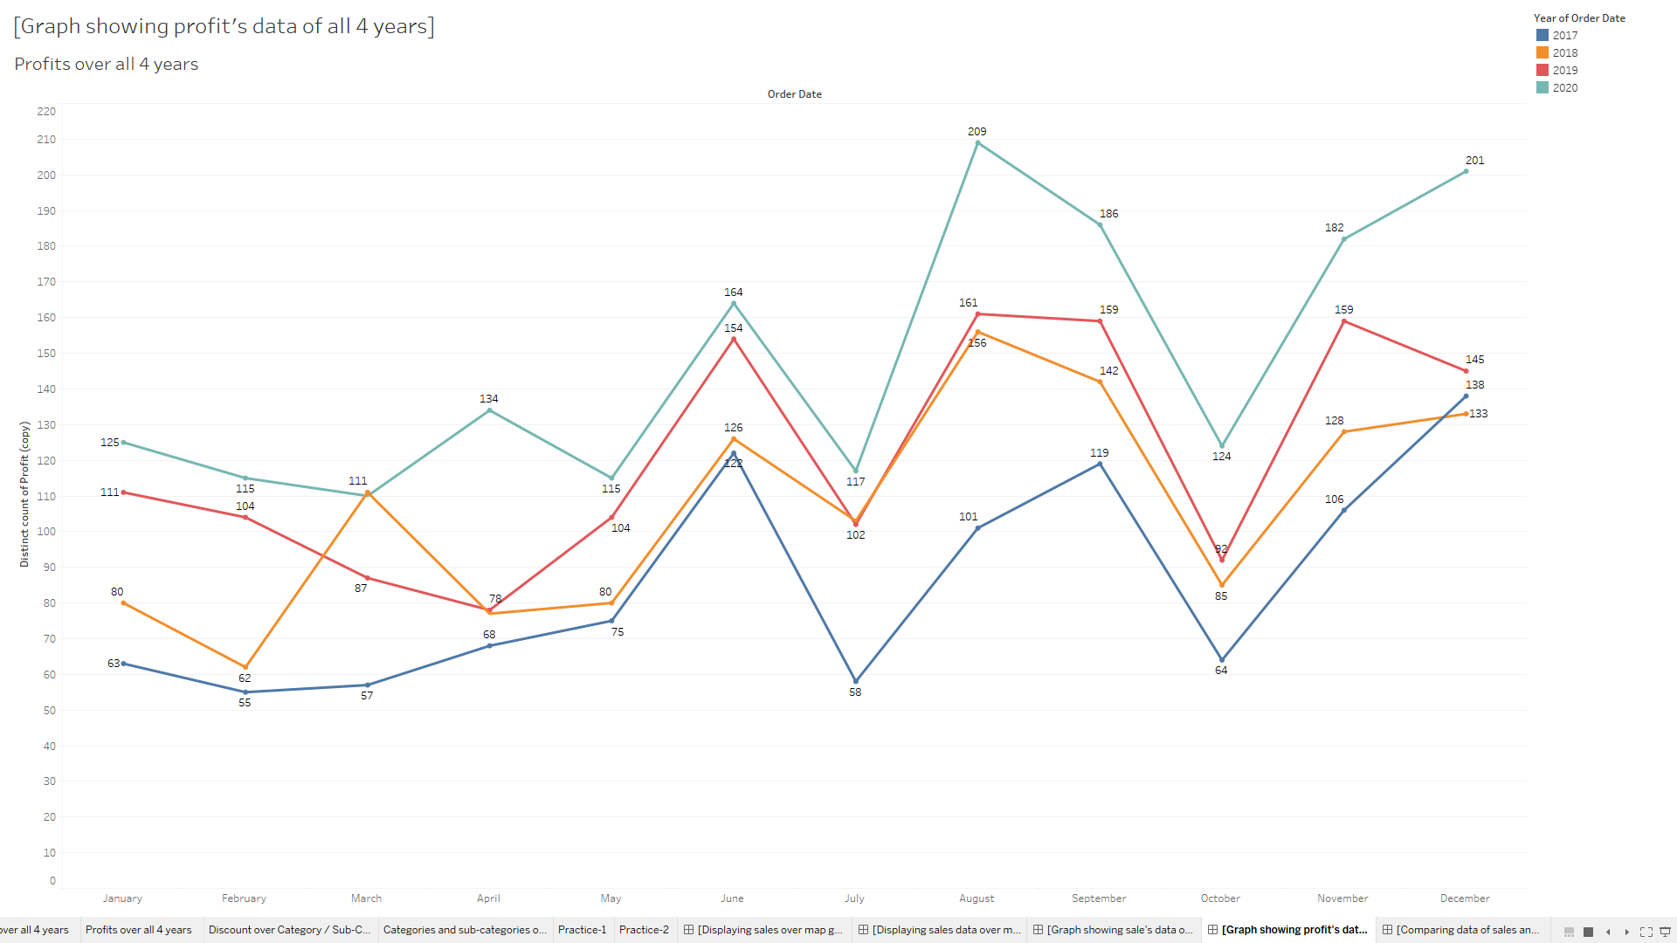

Slide 30
This dashboard4 is explaining about the relationship between profit by month-wise for all 4 years.
As compared to last graph this graph is more precise because its showing profit by month-wise for all the years as that would be much easy for seeing, understanding, viewing and taking important decisions.
Month-wise and year-wise data is shown with respect to profit.
Each year is indicated with different colour.
In the year 2017, the minimum profit is in February month with 55 and maximum profit is in December month with 138.
In the year 2018, the minimum profit is in February month with 62 and maximum profit is in August month with 156.
In the year 2019, the minimum profit is in April month with 78 and maximum profit is in August month with 161.
In the year 2020, the minimum profit is in March month with 110 and maximum profit is in August month with 209.

Slide 31
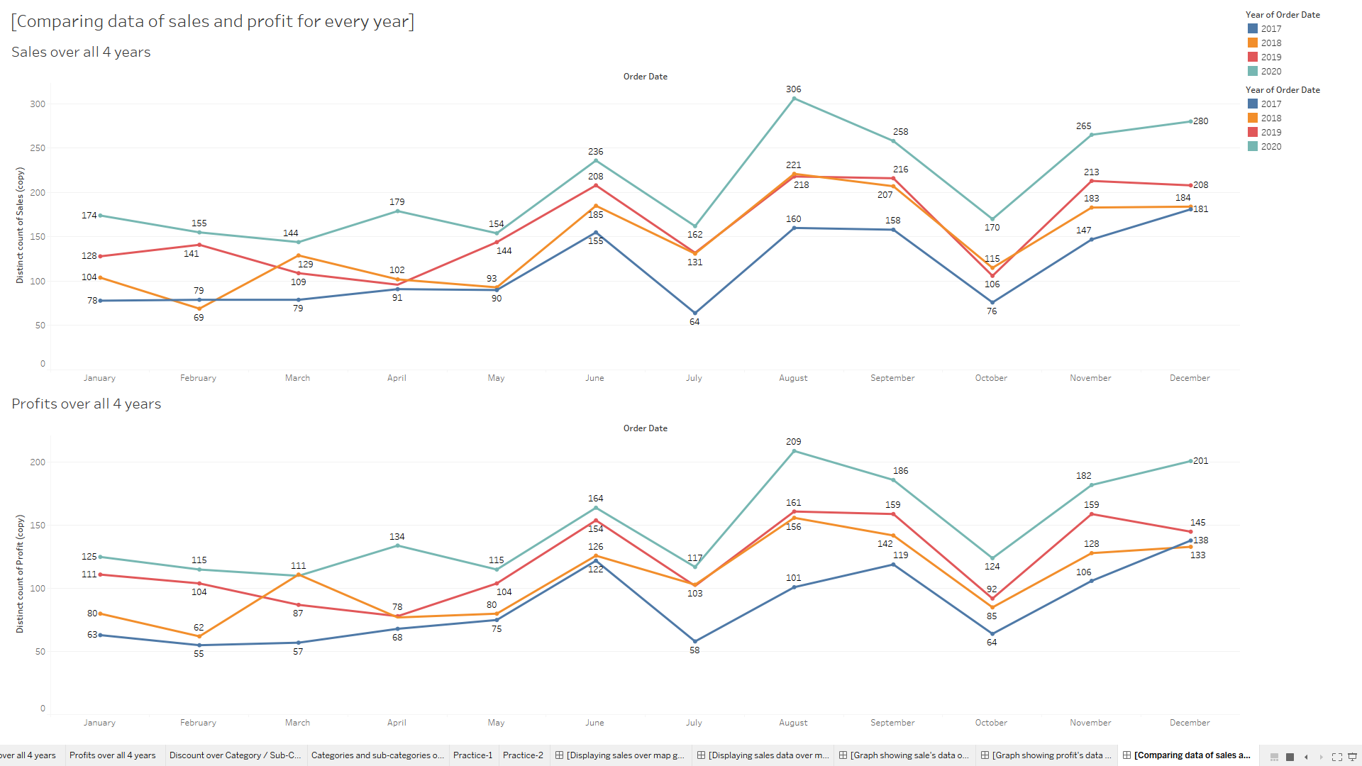

Slide 32
This dashboard5 is containing the dashboard3 and dashboard4.
Dashboard3 contains data of sales over 4 years.
Dashboard4 contains data of profit over 4 years.
In Dashboard5 can we can compare the data of sales and profit for 4 years all under in single dashboard.
Both the graphs are interrelated to each other.
They are interrelated to each in other in such a way that if you click on any month of any year from sales graph then the profit graph will show the profit earned for that month from that year.
They are interrelated to each in other in such a way that if you click on any month of any year from profit graph then the sales graph will show the sales earned for that month from that year.

Slide 33


